Slide 1
The most visited places in london
Vladylav Shevchenko

Slide 2
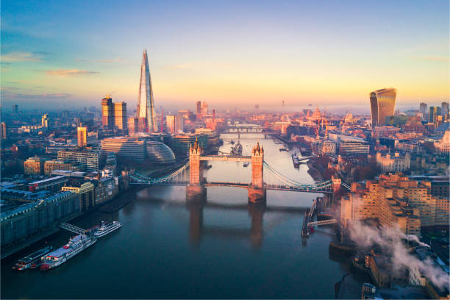
Introduction
Introduction: Welcome to our presentation on the most visited place in London. London, the vibrant capital of the United Kingdom, holds a special place in the hearts of travelers around the world. Today, we'll explore the key attractions that draw millions of tourists to this iconic city.

Slide 3
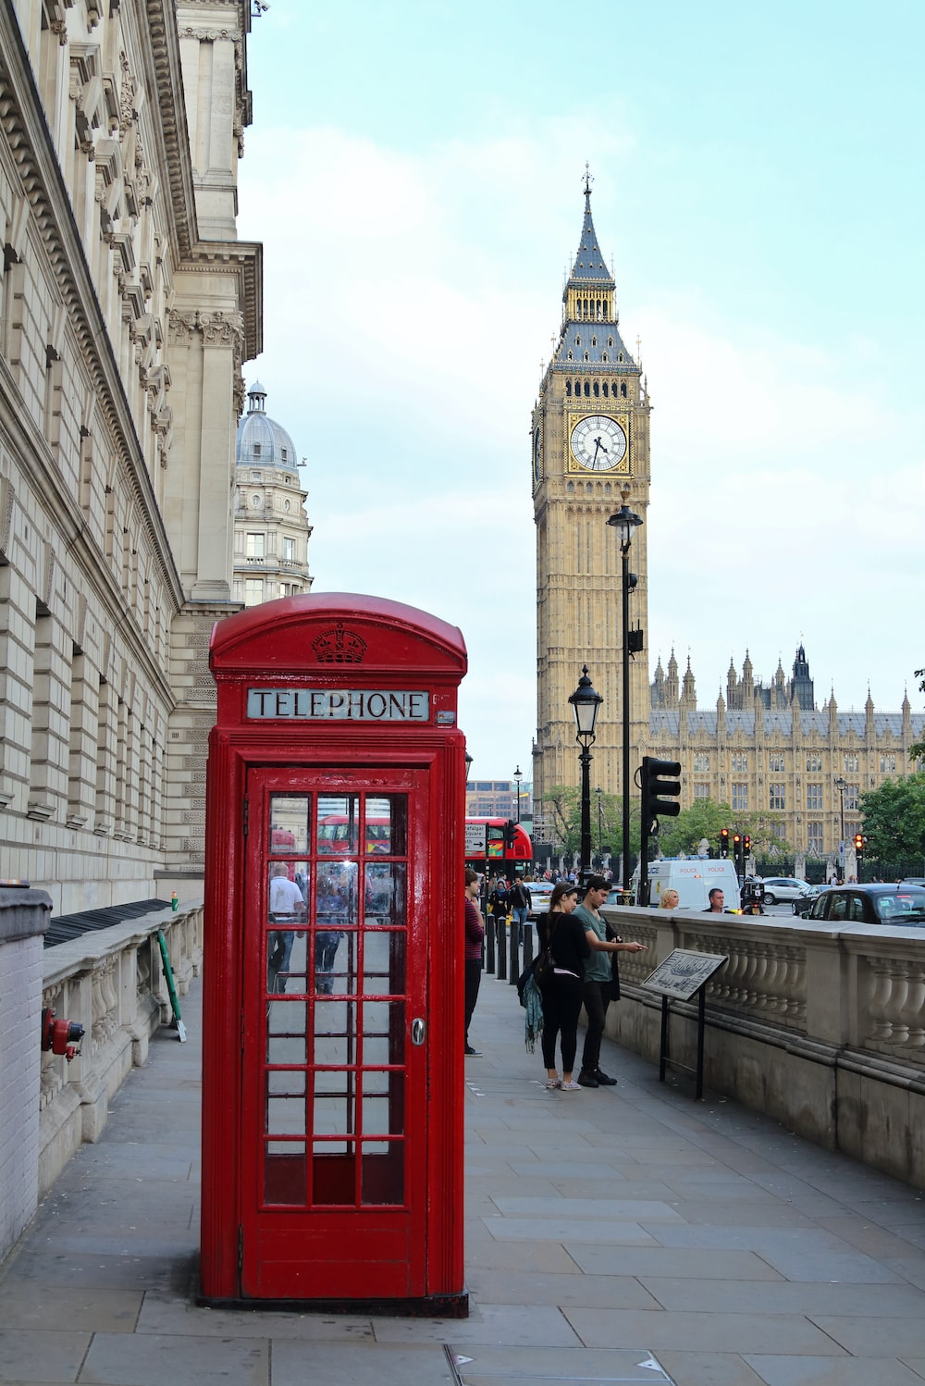
London Overview
London Overview: London, situated in the southeastern part of England, is a sprawling metropolis with a rich history dating back to Roman times. It is home to over 8 million people and is renowned for its diverse culture, historical landmarks, and modern amenities.

Slide 4
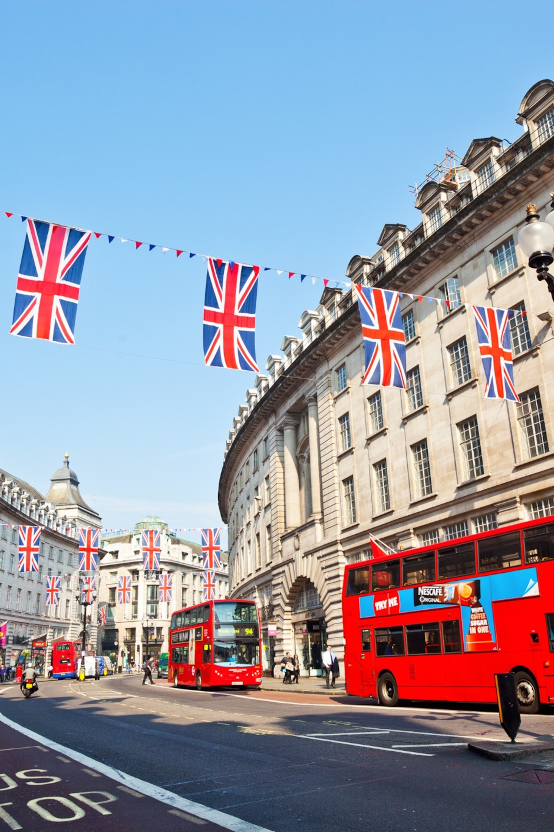
Significance of Local Attractions
Significance of Local Attractions: London's global appeal is in no small part due to its vast array of historical and cultural attractions. These iconic sites not only showcase the city's history but also offer unique experiences to tourists from all walks of life.

Slide 5
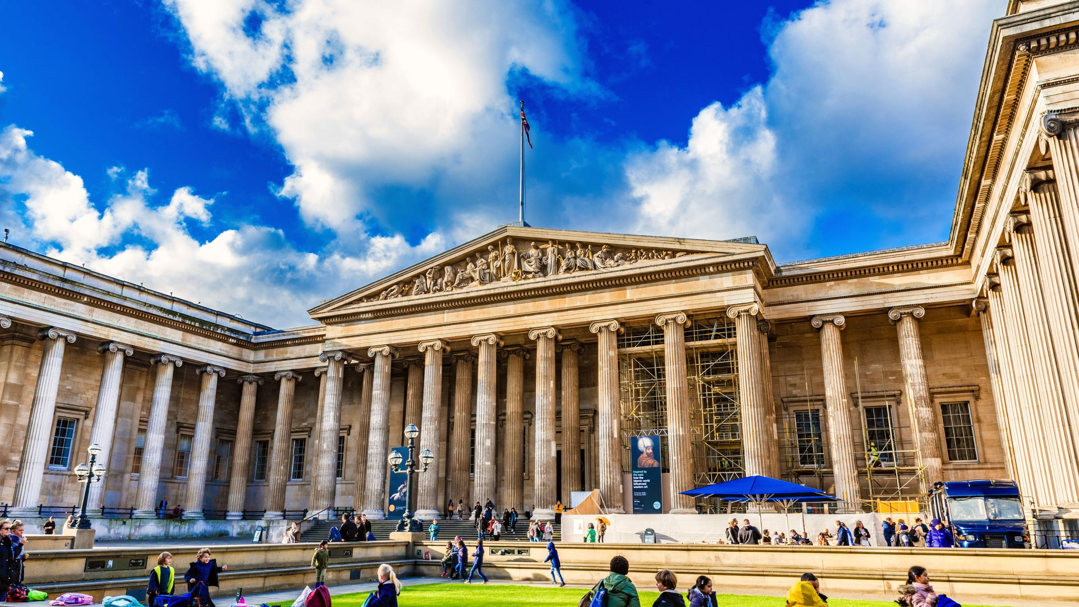
Top 5 Attractions
Top 5 Attractions: Let's dive into the top five most visited places in London, each offering a distinct perspective on this incredible city.
The British Museum
The Tower of London
Buckingham Palace
The London Eye
The Tate Modern

Slide 6
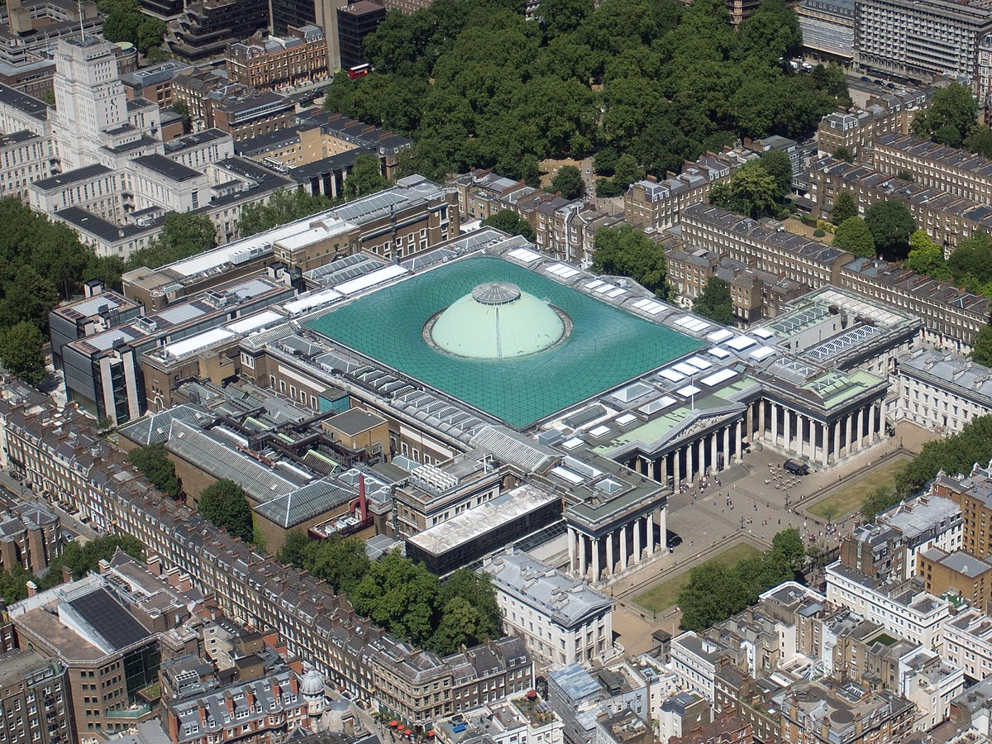
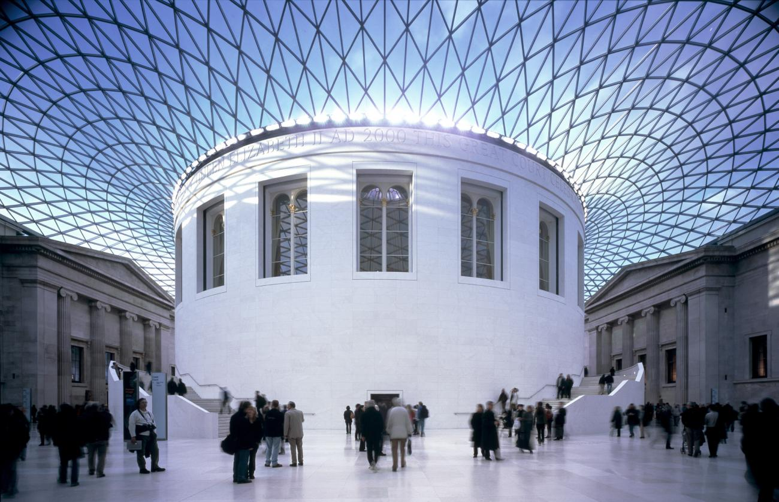
The British Museum
The British Museum is one of the most astonishing places in London and in the world. It houses over 8 million artifacts from various epochs and cultures. Visitors can explore treasures from ancient civilizations and contemporary art. The museum's crown jewel is the Rosetta Stone, where history and art beautifully intersect.

Slide 7
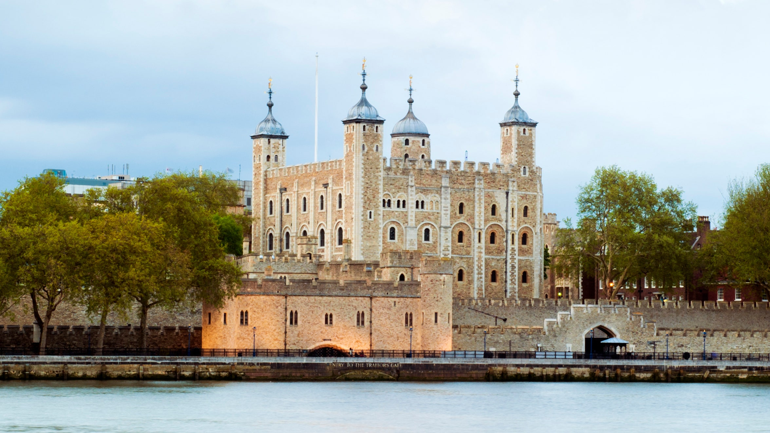
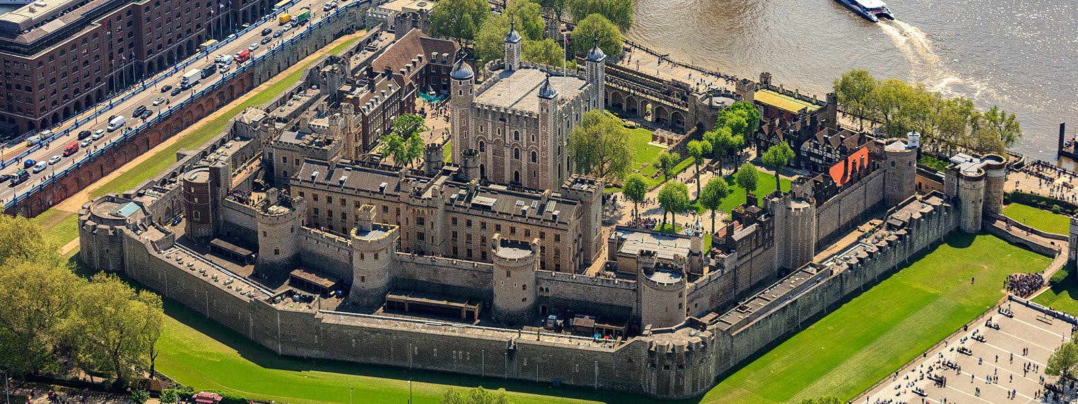
The Tower of London
The Tower of London is a historic complex, featuring a castle, walls, and numerous towers that played a significant role in British history. It is home to the Crown Jewels, including the Royal Crown. A visit to the Tower allows you to immerse yourself in history and learn about famous prisoners and events that took place within these walls.

Slide 8
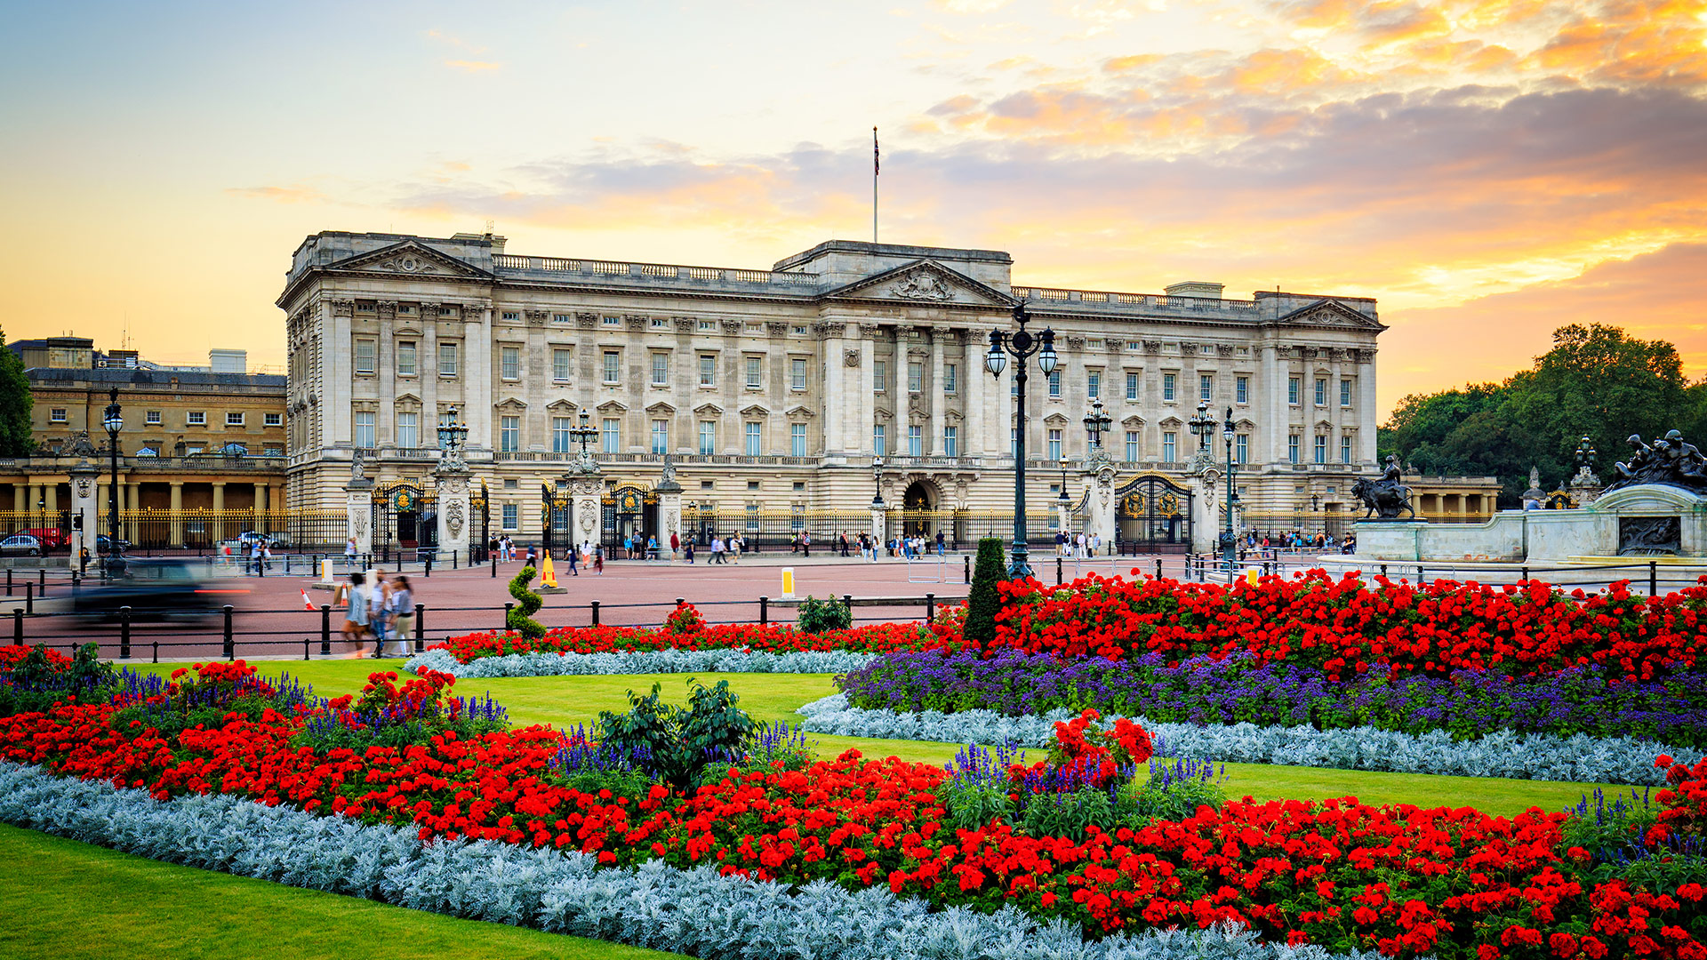
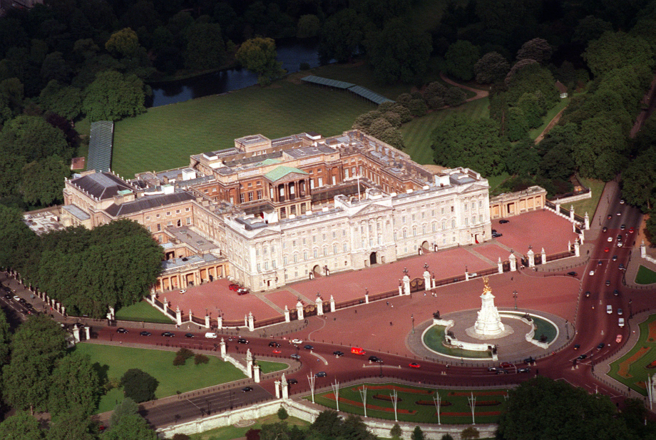
Buckingham Palace
Buckingham Palace serves as the official residence of the British monarch in London. It symbolizes royal authority and is a national emblem of the United Kingdom. Visitors can witness the Changing of the Guard ceremony, making it one of the most popular tourist attractions.

Slide 9
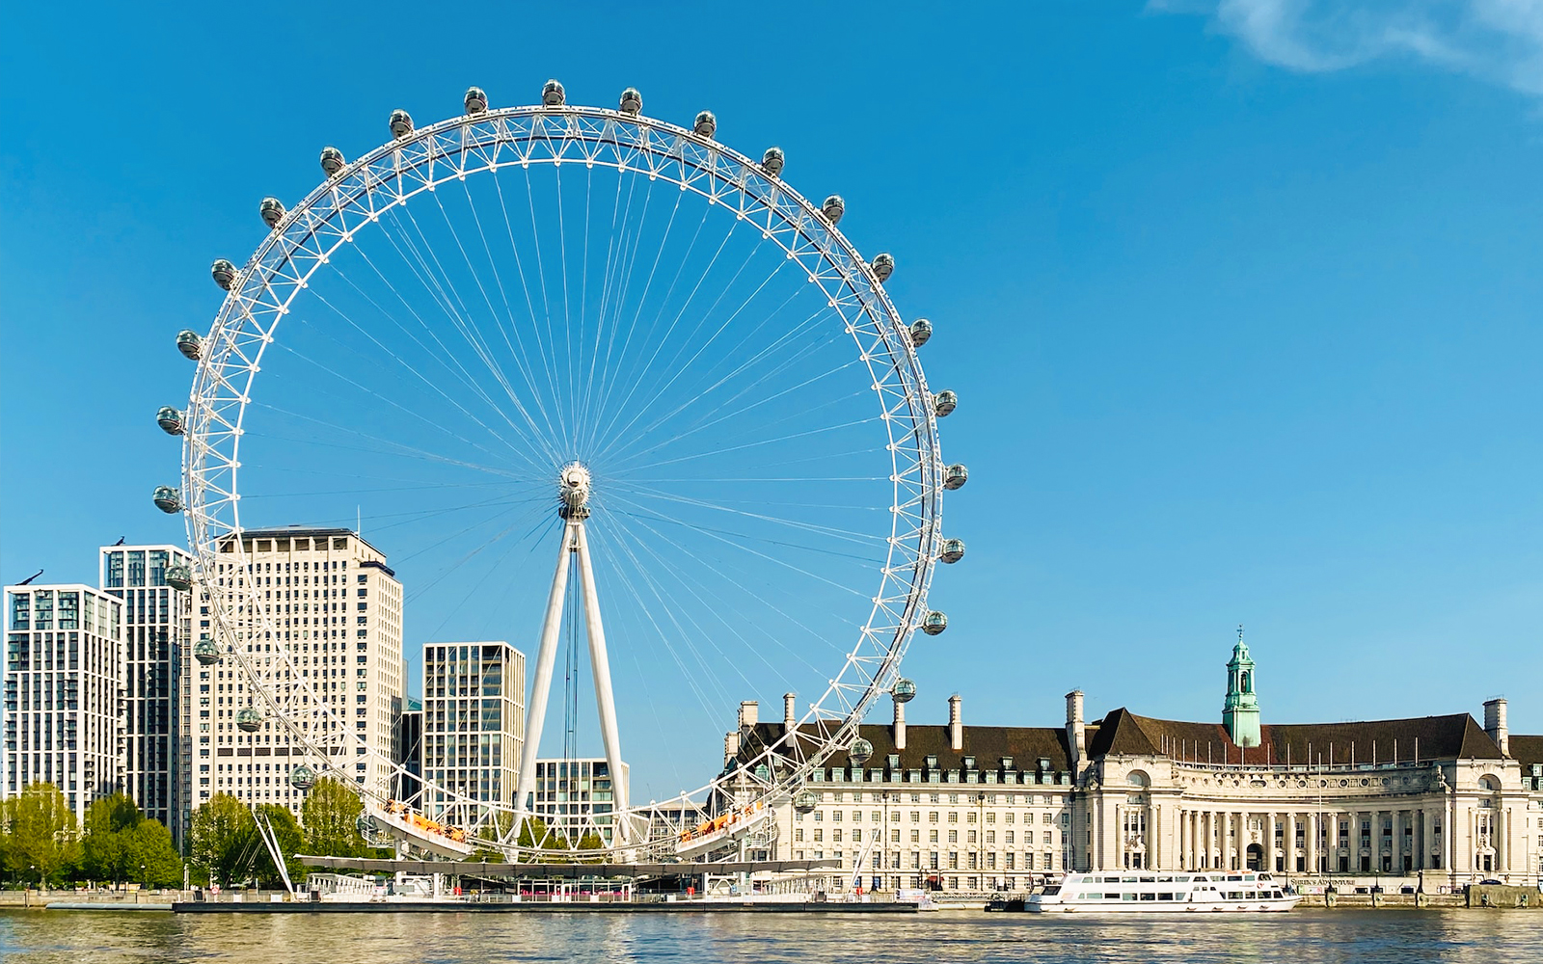
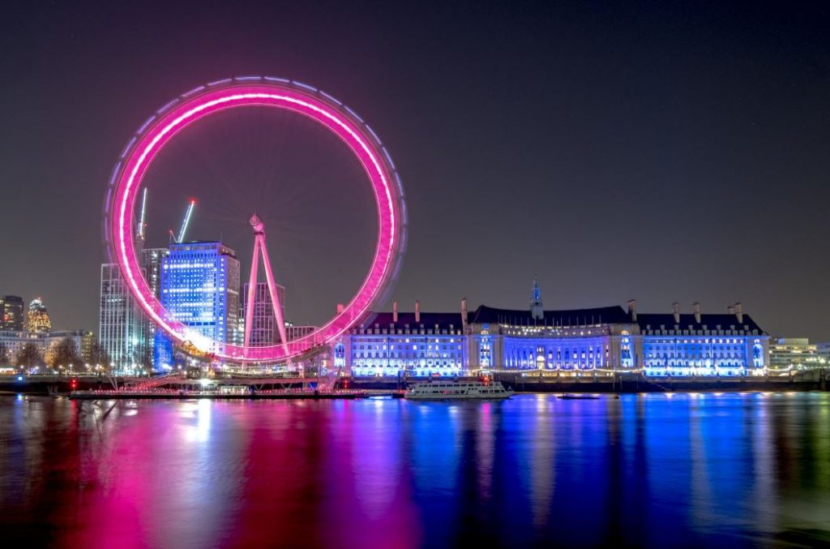
The London Eye
The London Eye is a giant observation wheel located on the South Bank of the River Thames, offering breathtaking panoramic views of the city. From the heights of the London Eye, you can enjoy an unparalleled bird's-eye view of London, including iconic landmarks such as Big Ben and the Parliament.

Slide 10
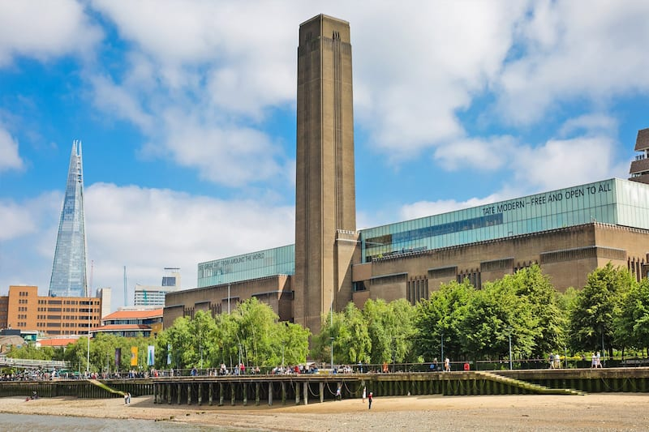
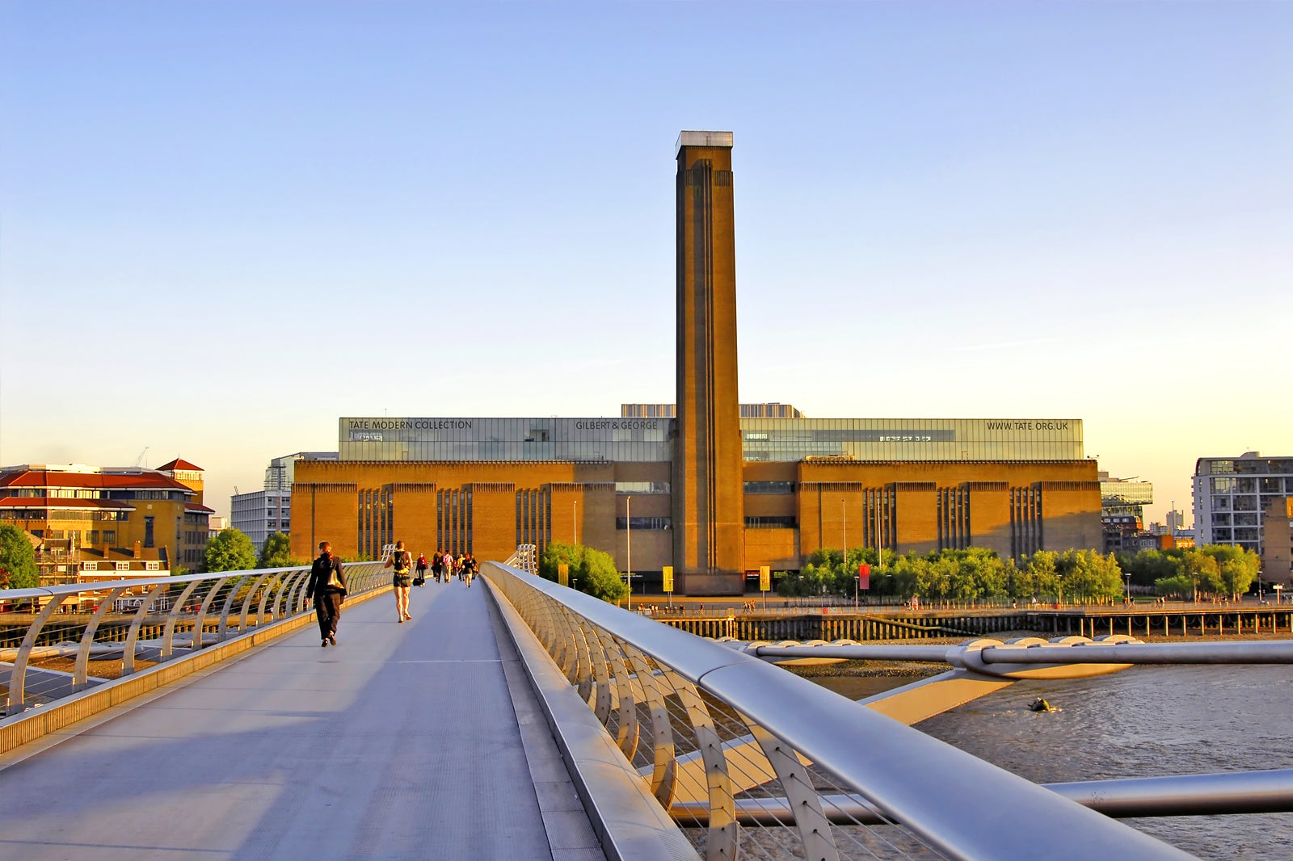
The Tate Modern
The Tate Modern is one of the world's foremost contemporary art museums. Housed in a converted power station, it boasts a rich collection of modern and contemporary art. Here, you can find works by renowned artists like Pablo Picasso, Andy Warhol, and many others. The museum also offers a stunning view of the River Thames and the city.

Slide 11
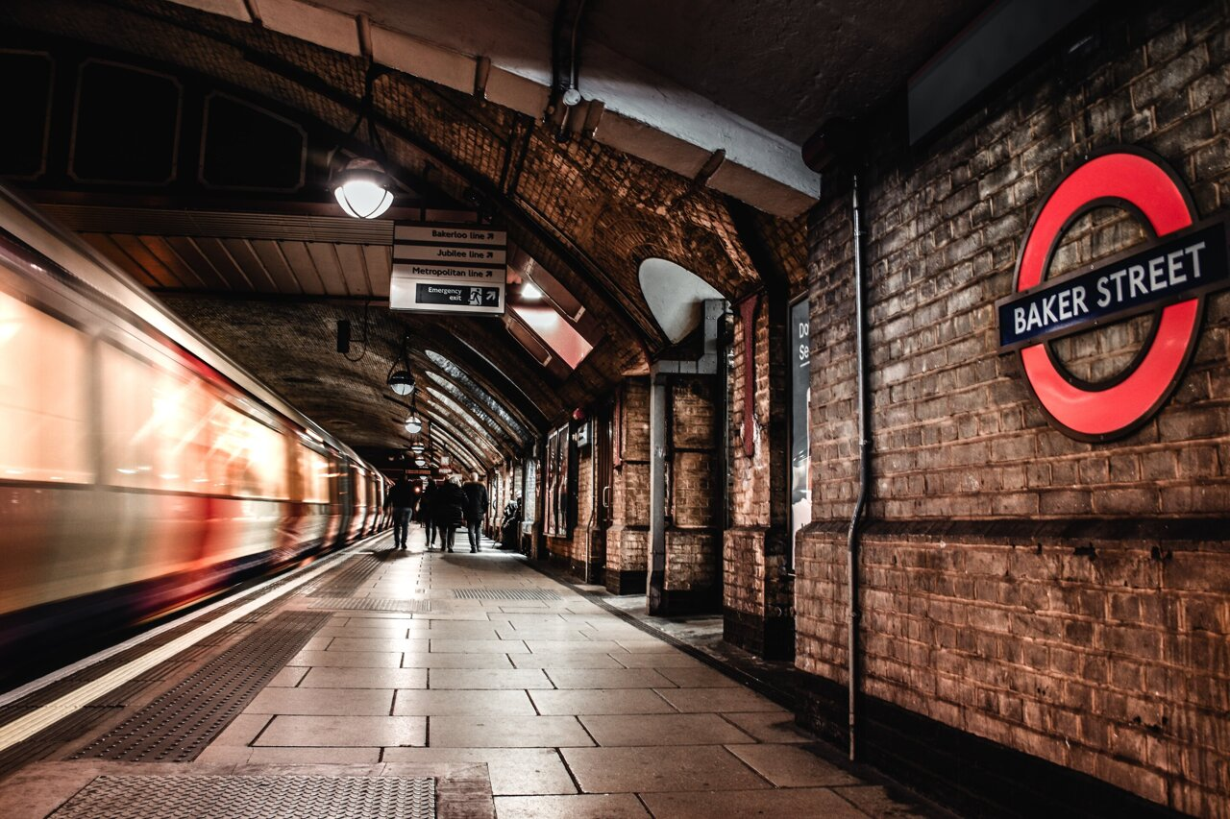
Interesting Facts About London
Interesting Facts About London: Did you know that London's Underground is the world's oldest metro system, dating back to 1863? Stay tuned for more intriguing tidbits!

Slide 12
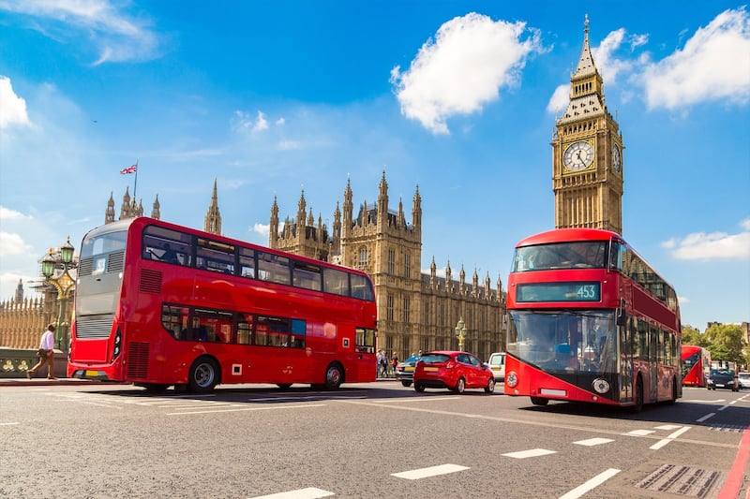
Tourism in London
Tourism plays a significant role in London's economy. The city attracts millions of tourists from around the world year after year. The tourism industry contributes substantially to the city's economy through accommodations, restaurants, shops, and various supplementary services. London extends a warm welcome to every visitor and offers a wide range of entertainment and cultural activities.

Slide 13
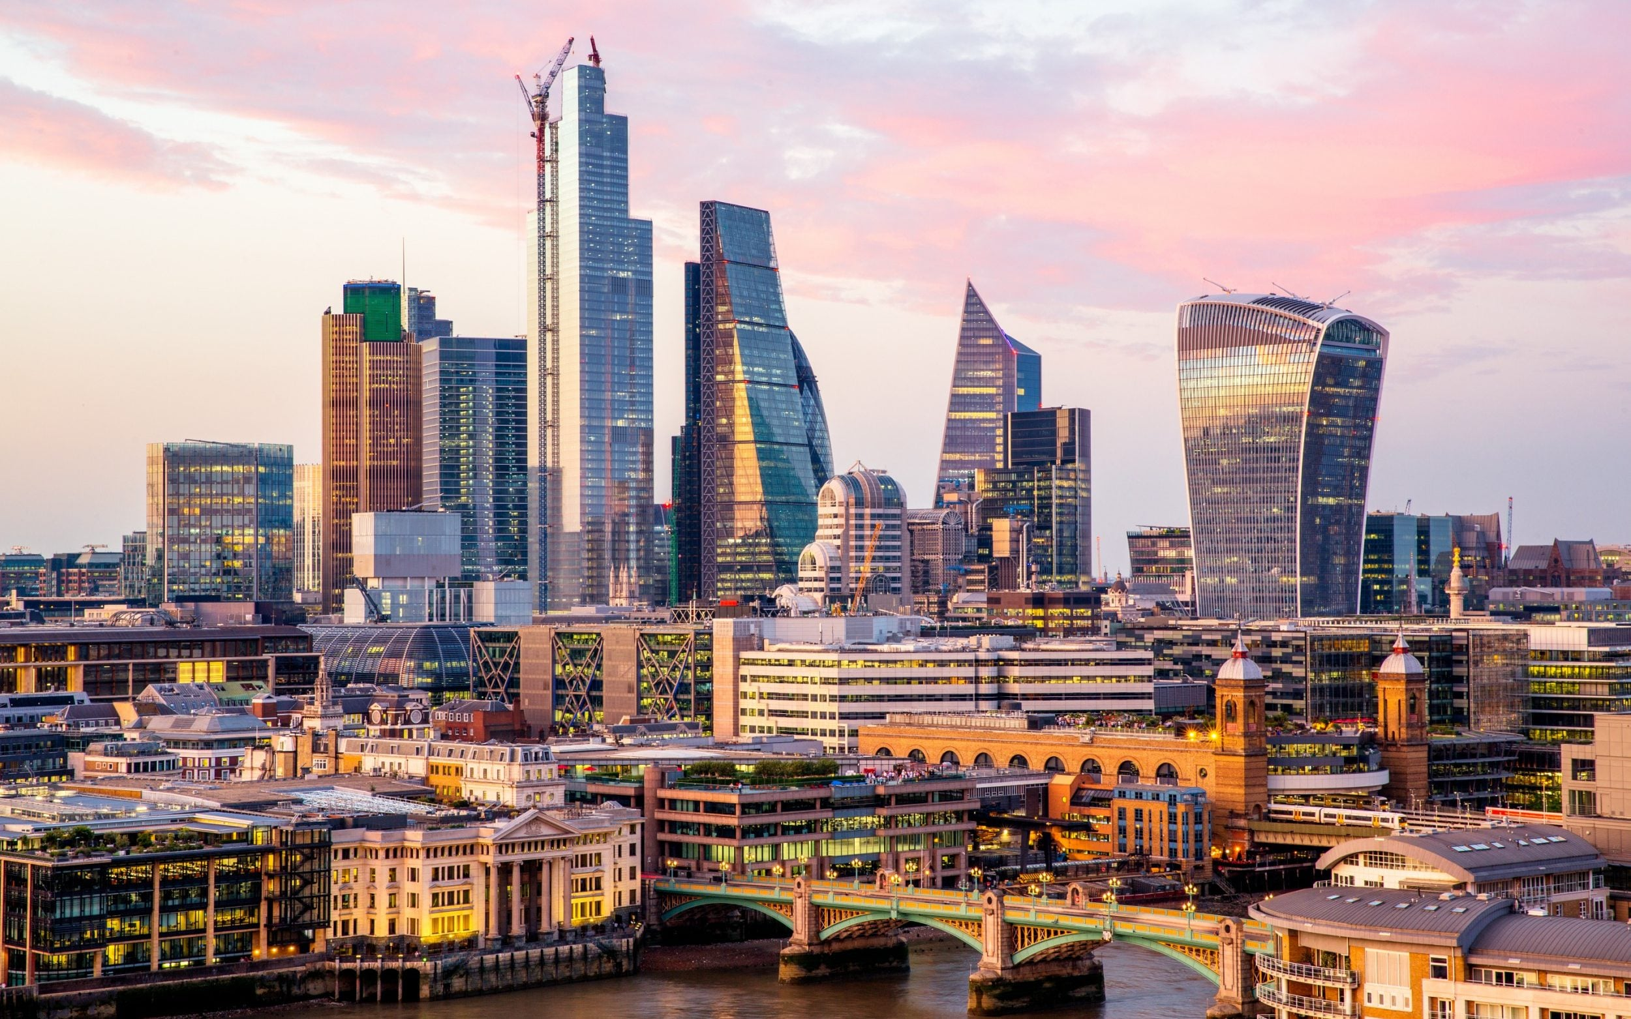
Measuring Popularity
Take a look at this chart, illustrating the popularity of each of these attractions based on the annual number of visitors. We can see that each of these places draws a huge number of tourists, emphasizing their importance in London's tourism industry.

Slide 14
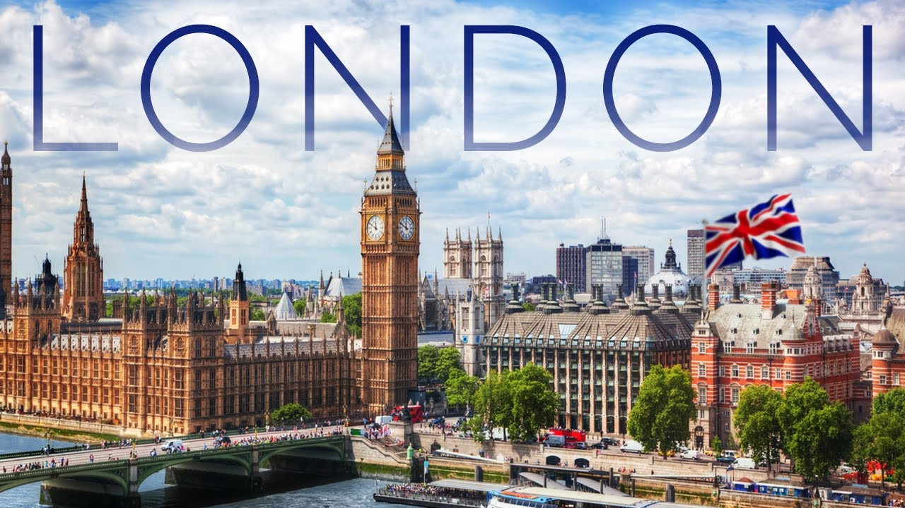
Tips for Tourists
For tourists visiting London, it's essential to have a plan and strategy to make the most of their trip. It's recommended to plan visits to the major attractions in advance, book tickets ahead of time, and utilize public transportation for time and cost efficiency. Gaining insight into London's peculiarities and culture enhances the overall travel experience.

Slide 15
Thank you for your attention.

